Slide 1
Error Detection And Correction Techniques
A presentation by: MC-NIEL CHINEDU - 169074008
In partial fulfilment of the course csc 831

Slide 2
Outline of this Presentation
Preamble
Data-Link Layer
Definition Of The Key Terms
Error Detection and its Methods
Error Correction and its Methods
Conclusion
References

Slide 3

Human Errors And Their Consequences
Lunch: A light meal usually eaten around midday
Launch: To Send or Propel into Space / Water

Slide 4
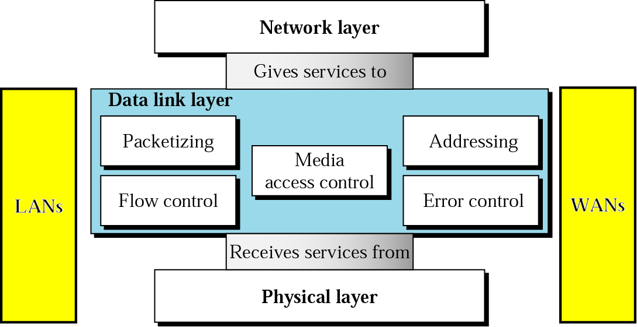
Data-Link Layer

Slide 5
Definition of ERROR.
Error: an impairment introduced to data which changes the accuracy of the data.
Environmental interference and physical defects in the communication medium can cause random bit errors during data transmission

Slide 6
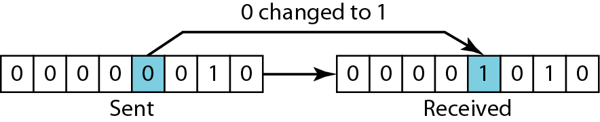
Types Of Error
Single-bit Error
single-bit error means that only one bit of given data unit (such as a byte, character, or data unit) is changed from 1 to 0 or from 0 to 1 as shown below.

Slide 7
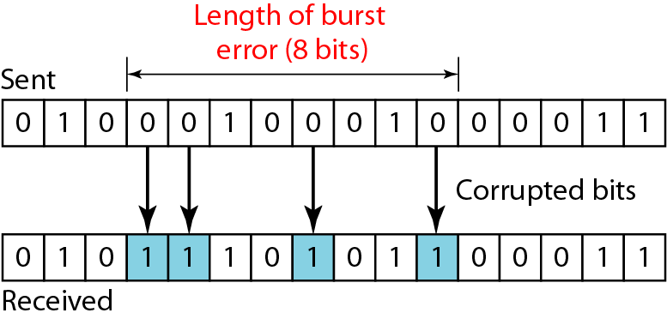
Types of Error.
Burst Error
Burst error means that two or more bits in the data unit have changed from 0 to 1 or vice-versa. Note that burst error doesn’t necessary means that error occurs in consecutive bits. The length of the burst error is measured from the first corrupted bit to the last corrupted bit. Some bits in between may not be corrupted.

Slide 8
Error Detection vs. Error Correction
Error detection is the detection of errors caused by noise or other impairments during transmission from the transmitter to the receiver.
Error correction is similar to error detection, except that a receiver cannot only detect whether errors have been
introduced in the frame but can also determine exactly where in the frame the errors have occurred and hence correct these errors.
Error detection and correction has great practical importance in maintaining data integrity across noisy Communication Networks channels and less than- reliable storage media.

Slide 9
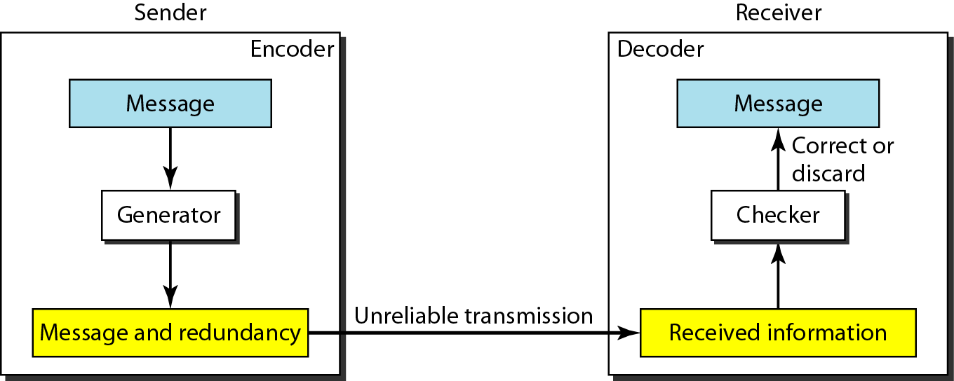
Inner Workings Of Error Correction

Slide 10
Error detection flowcharts. (Focus on Redundancy bits)
EDC = Error Detection and Correction bits (Redundancy)
D = Data protected by error checking, may include header fields

Slide 11
ERROR DETECTION – Proper Explanation
SIMPLE PARITY CHECKS -
CHECKSUM -
CYCLIC REDUNDANCY CHECK -

Slide 12
SIMPLE PARITY CHECKS
In this technique, a redundant bit called parity bit, is appended to every data unit so that the number of 1s in the unit (including the parity becomes even or odd). These Are Known as Odd Parity and Even Parity
Performance:
Simple parity check can detect all single-bit errors. It can also detect burst errors as long as the total number of bits changed is odd. This method cannot detect errors where the total number of hits changed is even.
2 DIMENTIONAL PARITY CHECKS
Same Concept but with a 2-dimensional matrix-like check for bit errors.
Performance
Two-dimensional parity check increases the likelihood of detecting burst errors.

Slide 13
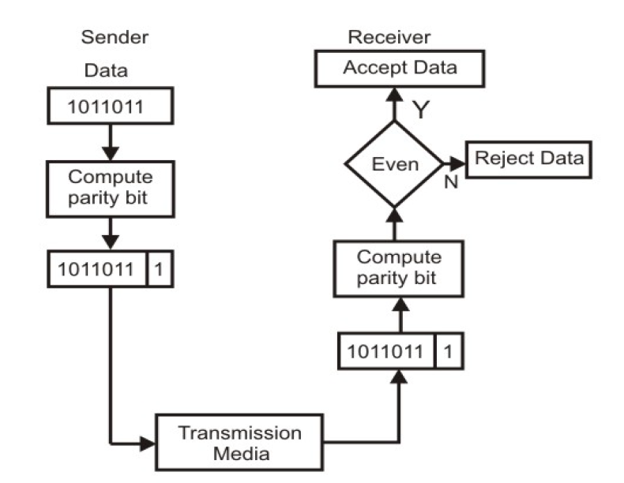

Slide 14
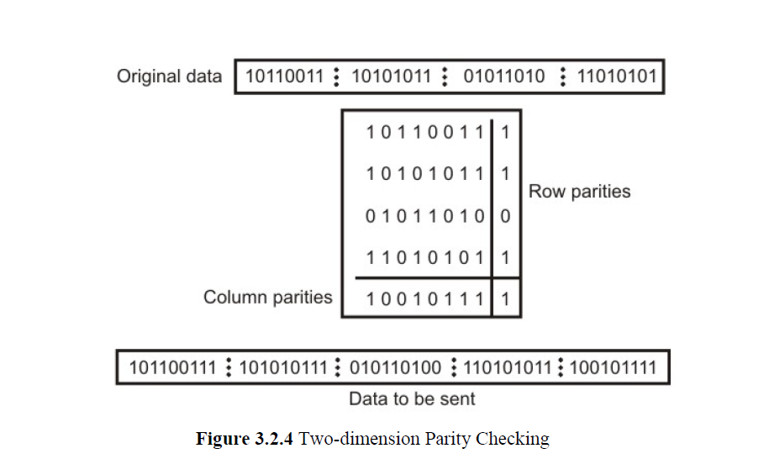

Slide 15
CHECKSUM
A checksum of a message is a modular arithmetic sum of message code words of a fixed word length (e.g., byte values). The sum may be negated by means of a ones’-complement operation prior to transmission to detect errors resulting in all-zero messages
Checksum schemes include parity bits, check digits, and longitudinal redundancy checks. Some checksum schemes, such as the Damn Algorithm, the Luhn algorithm, and the Verheoff Algorithm, are specifically designed to detect errors commonly introduced by humans in writing down or remembering identification numbers.

Slide 16
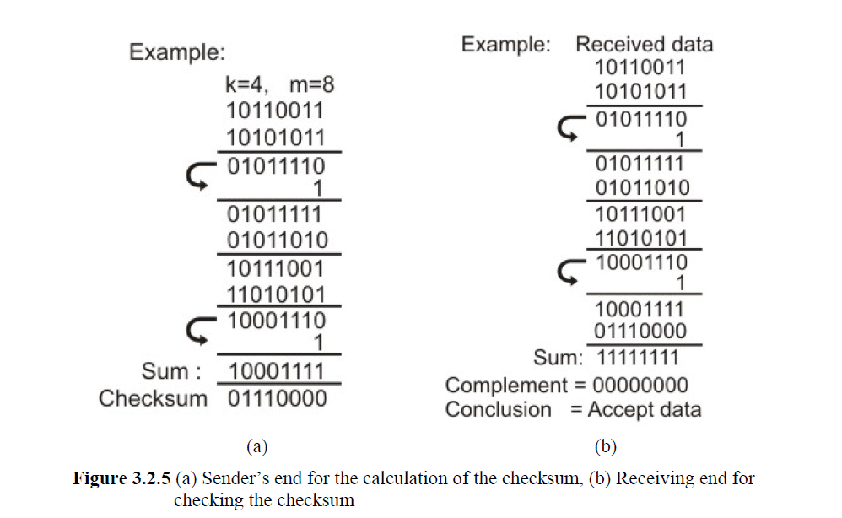

Slide 17
CYCLIC REDUNDANCY CHECK (CRC)
CRC is a different approach to detect if the frame received contains valid data. This technique involves binary division of the data bits being sent. The divisor is generated using polynomials. The sender performs a division operation on the bits being sent and calculates the remainder. Before sending the actual bits, the sender adds the remainder at the end of the actual bits. Actual data bits plus the remainder is called a codeword. The sender transmits data bits as codewords.
Performance of CRC
CRC is a very effective error detection method. If the divisor is chosen according to the previously mentioned rules,
1.CRC can detect all burst errors that affect an odd number of bits.
2.CRC can detect all burst errors of length less than or equal to the degree of the polynomial
3.CRC can detect, with a very high probability, burst errors of length greater than the degree of the polynomial.

Slide 18
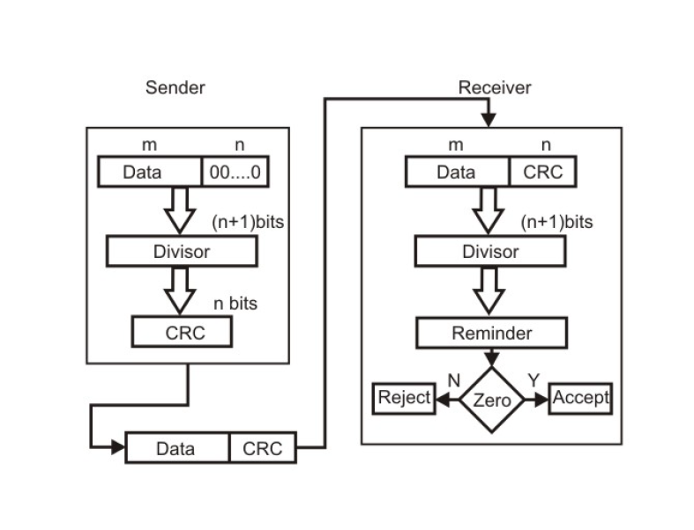
CRC Technique Flowchart

Slide 19
Error Correction Techniques
Error Correction can be handled in two ways.
Backward Error Correction (also known as Automatic Repeat-Request): when an error is discovered; the receiver can have the sender retransmit the entire data unit.
Forward Error Correction: here receiver can use an error-correcting code, which automatically corrects certain errors.

Slide 20
Backward Error Correction
Backward Error Correction, is simple and can only be efficiently used where retransmitting is not expensive, for example fiber optics. But in case of wireless transmission retransmitting may cost too much. In the latter case, Forward Error Correction is used.

Slide 21
Forward Error Correction
Consider only a single-bit error in k bits of data
k possibilities for an error
One possibility for no error
#possibilities = k + 1
Add r redundant bits to distinguish these possibilities; we need
2^{r} ≥ k+1
But the r bits are also transmitted along with data; hence
2^{r} ≥ k+r+1

Slide 22
Redundancy Number Table
Number of data bits (k) | Number of Redundancy Bits (r) | Total Bits (k+r)
1 | 2 | 3
2 | 3 | 5
3 | 3 | 6
4 | 3 | 7
5 | 4 | 9
6 | 4 | 10
7 | 4 | 11

Slide 23
HAMMING CODE
It is a technique developed by R.W.Hamming.
Hamming code can be applied to data units of any length and uses the relationship between data and redundancy bits.
For eg.
A 7 bit ASCII code requires 4 Redundancy bits that can be added to the end of the data unit or interspersed with the original data bits.
These bits are placed in positions 1,2,4 and 8. We refer to these bits as r1,r2,r4 and r8.

Slide 24
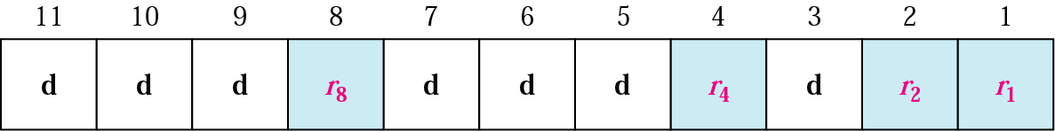
Hamming Code
Simple, powerful FEC
Widely used in computer memory
Known as ECC memory
error-correcting bits

Slide 25
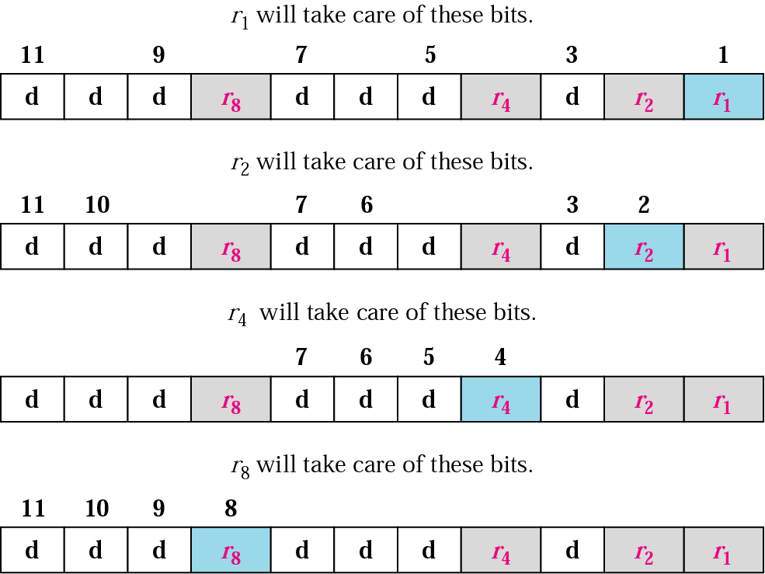
Redundant Bit Calculation

Slide 26
In the Hamming code, each r bit is the VRC bit for one combination of data bits :
- r1 is the one combination of data bits.
- r2 is another combination of data bits.
and so on.
The combination used to calculate each of the four values for a 7 bit data sequence are as follows :
- r1 : bits 1,3,5,7,9,11.
- r2 : bits 2,3,6,7,10,11.
- r4 : bits 4,5,6,7.
- r8 : bits 8,9,10,11.

Slide 27
Data : 1 0 0 1 1 0 1
Data
1 | 0 | 0 |  | 1 | 1 | 0 |  | 1
Adding r1
1 | 0 | 0 |  | 1 | 1 | 0 |  | 1 |  | 1
Adding r2
1 | 0 | 0 |  | 1 | 1 | 0 |  | 1 | 0 | 1
Adding r4
1 | 0 | 0 |  | 1 | 1 | 0 | 0 | 1 | 0 | 1
Adding r8
1 | 0 | 0 | 1 | 1 | 1 | 0 | 0 | 1 | 0 | 1
11
10
9
8
7
6
5
4
3
2
1
Code : 1 0 0 1 1 1 0 0 1 0 1

Slide 28
1 | 0 | 0 | 1 | 1 | 1 | 0 | 0 | 1 | 0 | 1
Sent
Error
1 | 0 | 0 | 1 | 0 | 1 | 0 | 0 | 1 | 0 | 1
Received

Slide 29
1 | 0 | 0 | 1 | 0 | 1 | 0 | 0 | 1 | 0 | 1
11
10
9
8
7
6
5
4
3
2
1
1 | 0 | 0 | 1 | 0 | 1 | 0 | 0 | 1 | 0 | 1
11
10
9
8
7
6
5
4
3
2
1
1 | 0 | 0 | 1 | 0 | 1 | 0 | 0 | 1 | 0 | 1
11
10
9
8
7
6
5
4
3
2
1
1 | 0 | 0 | 1 | 0 | 1 | 0 | 0 | 1 | 0 | 1
11
10
9
8
7
6
5
4
3
2
1
The bit in position 7 is in error
0
1
1
1

Slide 30
Conclusion
Data Detection and Correction Techniques play a major role in helping us receive correct data: As sent by the sender.
Error Correction Helps us in integrity of data transmitted over the network.

Slide 31

YOU HAVE BEEN A WONDERFUL AUDIENCE

Slide 32
References
1. https://www.techopedia.com/definition/821/error-correction
2. http://csunplugged.org/error-detection/
3. http://www.csunplugged.org/wp-content/uploads/2014/12/unplugged-04-error_detection.pdf
4. https://learningnetwork.cisco.com/thread/4894
5. https://ariewibisono.wordpress.com/2014/04/14/data-link-layer-error-detection-and-correction/
6. http://ecomputernotes.com/computernetworkingnotes/communication-networks/what-is-error-correction-and-detection
7. http://www.networkinginfoblog.com/post/149/error-detection-and--correction-techniques/
8. http://nptel.ac.in/courses/106105080/pdf/M3L2.pdf
9. http://www.science.smith.edu/~jcardell/Courses/EGR328/Readings/KRch5Link.pdf
10. http://www.computerworld.com/article/2568133/business-intelligence/error-checking-and-correction.html
11. https://www.techopedia.com/definition/1796/error-detection
12. http://www.slideshare.net/kewalramani_renu/error-detection-and-correction-12980998?from_action=save
13. http://www.slideshare.net/saikrishnatanguturu/computer-networks-34379994?from_action=save
14. http://www.cs.hunter.cuny.edu/~saad/courses/networks/notes/note4.pdf
Computer Networking A Top-Down Approach by Kurose | Ross

